Slide 1
Shortcomings of Twitter As A Marketing Tool
Fadi Almazyad, Russell Davis, Walter Gerych
Group 10

Slide 2
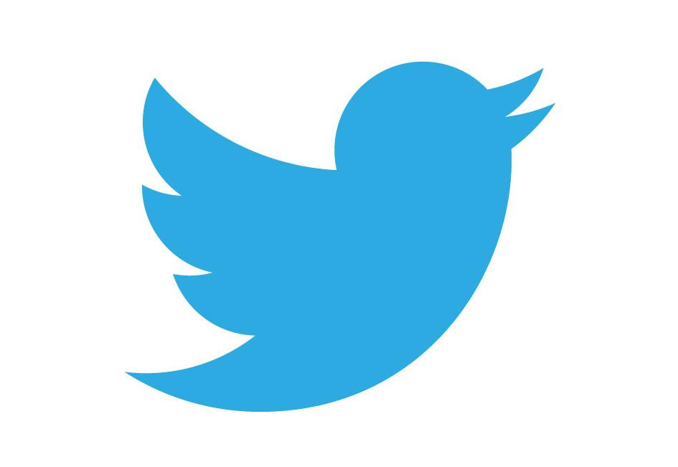
What is Twitter and how can it help?
Media platform where users can broadcast short thoughts to the world
Tweets contain hashtags, text, and can be directed at specific people
Analyzing the messages and quantity of tweets can tell you a great deal about how people view a concept
Applies to anything from sports to natural disasters
Widespread use as a marketing tool

Slide 3
Proposed Business Plan
Assess brand strength and consumer sentiment using Twitter
In general, we expect a large Twitter following to correlate positively with sales
Find failing or failed companies with large Twitter base
We expect to negative sentiment associated with these companies
Work with them on reinventing themselves using Twitter marketing as a base to develop positive sentiment and encourage customers

Slide 4
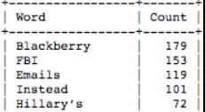
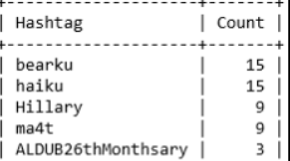
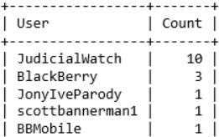
Assessing public opinion of Blackberry
Blackberry lost market share and stopped primary manufacturing in 2016
Their Twitter page still has 4.5 million followers
The top 30 words, after removing stop words, were not promising data.
How about hashtags and user mentions?
Notes:
The first question -- do people care at all?
The answer -- no

Slide 5
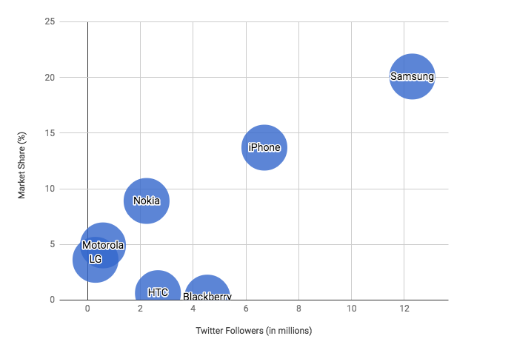
Let's Go Back To Smartphones
Consider the Twitter follower count for the various brands
Data from Q1 2016
Notes:
-Compare BB with competitors
-Expect positive corr. Follow and market, if not, then low sentiment for outliers
-Nope. HTC and BB outliers. Maybe b/c low sentiment.

Slide 6
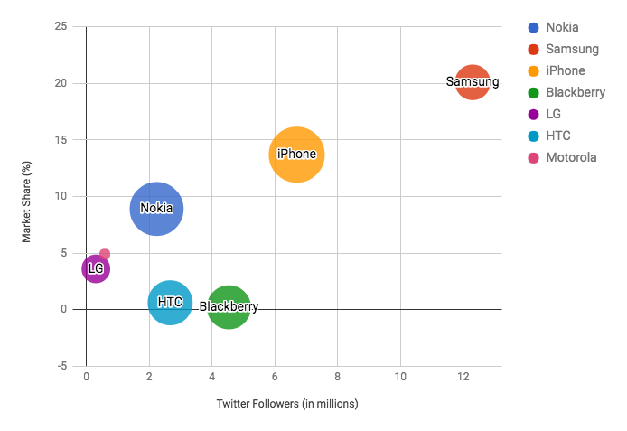
Smartphones: Twitter Followers, Market Share, and Sentiment Analysis
Notes:
-Incorporates sentiment of tweets directed at these companies.
-HTC and BlackBerry have relatively pos sent associated with them, still low market share.
Sentiment pulled from 200 most recent tweets directed at the companies’ twitter accounts

Slide 7
Is This Just Smartphones?
We also considered:
Console gaming
Sneakers
Cars

Slide 8
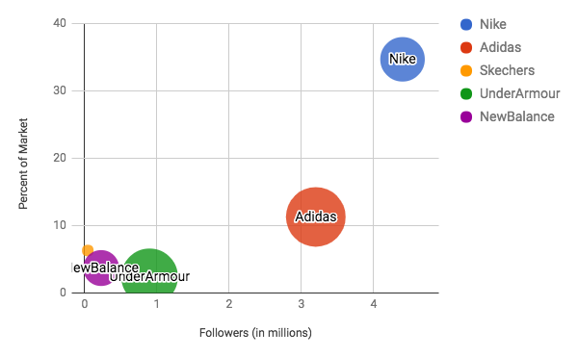
Sneakers: Twitter Followers, Market Share, and Sentiment Analysis

Slide 9
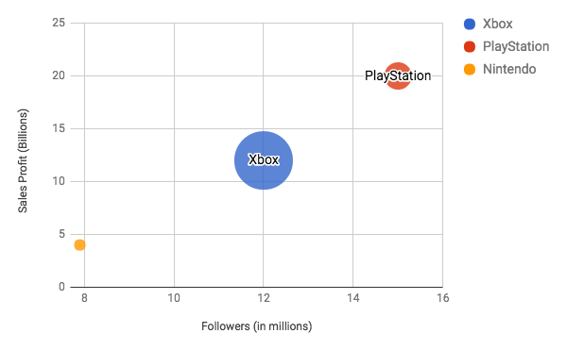
Console Gaming Platforms: Twitter Followers, Market Share, and Sentiment Analysis

Slide 10
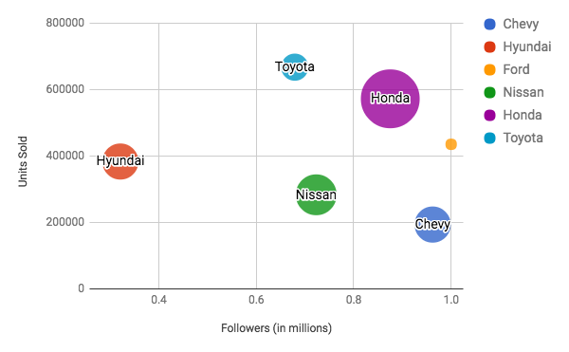
Cars: Twitter Followers, Market Share, and Sentiment Analysis

Slide 11
What do we make of this?
Overall lack of consistency
Sometimes more followers is indicative of a good thing
Sometimes it's not
Positive sentiment doesn't appear to say much at all
We probably didn't have enough context
Research indicates that there are key points in a product's life cycle where Twitter exposure can provide significant boosts to sales
Otherwise, it doesn't help nearly as much

Slide 12
Can we still have a business plan?
Twitter is full of data, but using data well is apparently not trivial
Our hypotheses didn't hold up to the results we found
What did we find?
Having a strong Twitter base is usually better than not having a Twitter base
Having positive sentiment is usually better than having negative sentiment
Based on the cited research, timing probably plays a large part in the results

Slide 13
Proposed Business Plan 2.0
Find companies with significant social media investment
Globally, $16 billion in 2014, $31 billion in 2016, and continuing to rise
Help them to develop the necessary flexibility in their social media approach
Larger investment at key moments for their products
Lower investment otherwise
Optimization is important!

Slide 14
Works Cited
Romero, Andrea. “Topic: Social Media Marketing.” www.statista.com, Statista, www.statista.com/topics/1538/social-media-marketing/.
Russell, Matthew. Mining the Social Web. O'Reilly Media, 2013. Oreilly.com. Web. Accessed 13 Sep 2017 shop.oreilly.com
Roberts, Daniel. “Adidas Has Nearly Doubled Its US Sneaker Market Share - at Nike's Expense.” Yahoo! Finance, Yahoo!, 23 June 2017, finance.yahoo.com/news/adidas-nearly-doubled-us-sneaker-market-share-nikes-expense-153106743.html.
“10 Most Cars: Here Are the Best Selling Cars in America for 2015.” Car and Driver, Car And Driver, www.caranddriver.com/flipbook/10-most-cars-here-are-the-bestselling-cars-in-america-for-2015.
Takahashi, Dean. “Sony Dominates Console Market with 57% Share Worldwide.” VentureBeat, 16 Mar. 2017, venturebeat.com/2017/03/16/sony-dominates-console-market-with-57-share-worldwide/.
Kumar, V., Choi, J.B. & Greene, M. J. of the Acad. Mark. Sci. (2017) 45: 268. https://doi.org/10.1007/s11747-016-0484-7
Hennig-Thurau, T., Wiertz, C. & Feldhaus, F. J. of the Acad. Mark. Sci. (2015) 43: 375. https://doi.org/10.1007/s11747-014-0388-3

